Slide 1
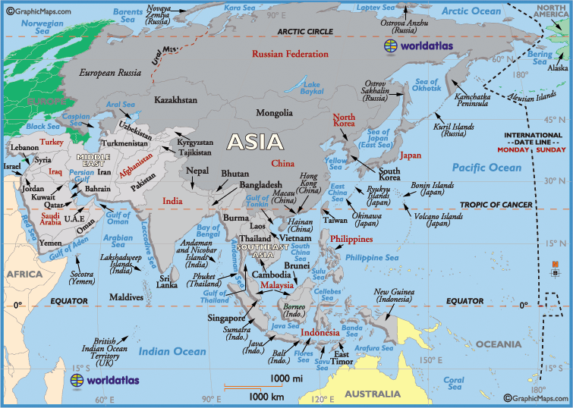
ASIA

Slide 2
China
Chinese Cuisine
Enjoy a nutritious cuisine
Meals include large amounts of rice and vegetables but only small amounts of meat.
Stir-fry, steam, or simmer many dishes
*** The combination of healthful ingredients and light cooking methods makes Chinese fairly low in fat.
Food is high in vitamins, minerals, and fiber
** One nutritional drawback- diet has a high sodium level due to much use of soy sauce.
Cuisine delights the senses.
Old proverb describes a well prepared dish as one that: “Smells appetizing as it is brought to the table. The dish must stimulate the appetite by its harmonious color combinations. The food must taste delicious and sound pleasing as it is being chewed.”
Today the best Chinese dishes still live up to these high standards

Slide 3
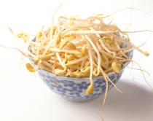
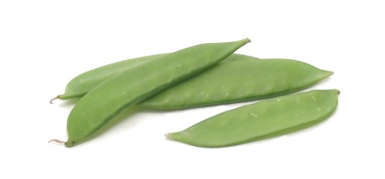
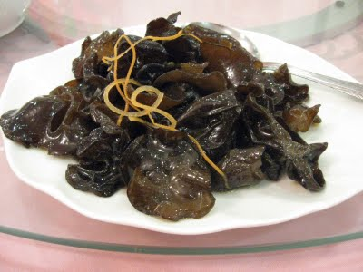
Chinese Ingredients
Popular Ingredients:
Bamboo Shoots
Bean Curd
Bean Sprouts
Bean Threads
Black Mushrooms
Chinese Cabbage
Chinese Pea Pods
Golden Noodles
Hoisin Sauce
Oyster Sauce
Soy Sauce
Water Chestnuts
Winter Melon
Wood Ears
Bean Sprouts
Pea Pods
Wood Ears

Slide 4
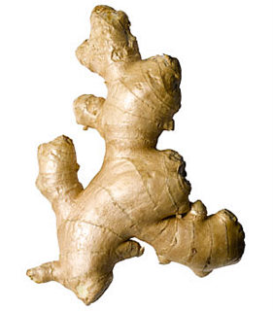
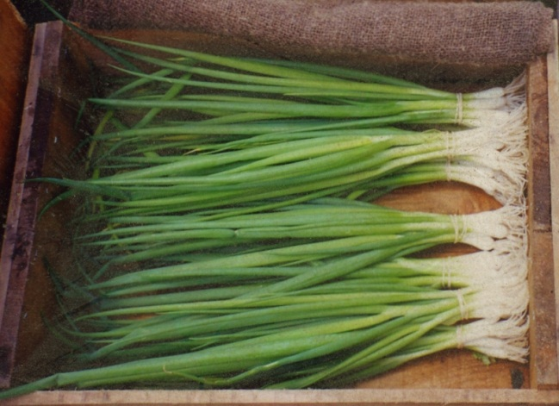
Chinese Ingredients
Cooks also use many seasonings
Important Seasonings:
Ginger Root
Scallions
Garlic
Sugar
Bean Paste
Fermented Black Bean
Monosodium Glutamate (MSG), hot pepper, sesame seed oil, star anise, Chinese peppercorns, and five spice powder are also common
Ginger Root
Scallions

Slide 5
Preparing Ingredients
Spend more time preparing food to be cooked than they spend cooking.
Most dishes cook so quickly, cooks must assemble all ingredients in advance.
Most preparation time involves:
Slicing
Chopping
Shredding
Dicing
Mincing
Of vegetables and meats
Cooks can prepare many ingredients hours or even days in advance and refrigerate until used.

Slide 6
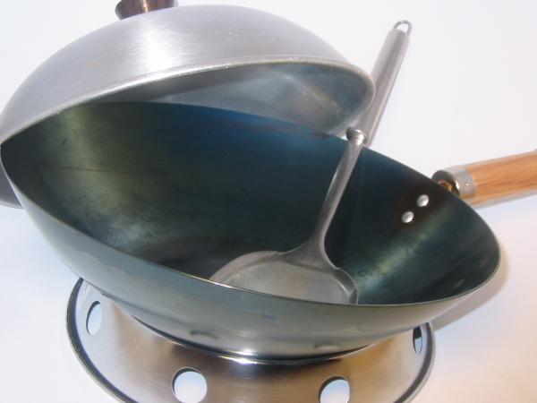
Chinese Cooking Utensils
Wok
the most versatile appliance
Looks like a metal bowl with sloping sides
Some have covers
Ideal for stir-fry because they conduct heat evenly and rapidly.
Few foods cannot be cooked in a wok
Steamer
Looks like a round, shallow basket with openings

Slide 7
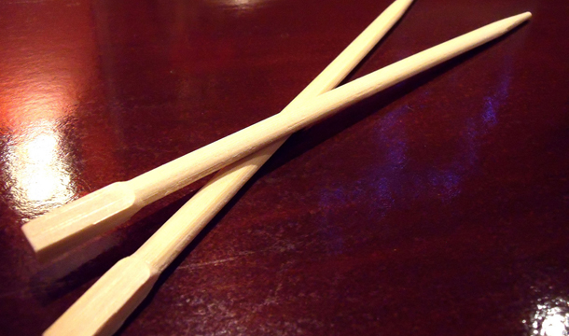
Chinese Cooking Utensils
Cleaver
Because Chinese eat with chopsticks, cooks must cut all ingredients into pieces that diners can handle easily.
Use cleavers to perform all cutting tasks as well as crushing and pounding tasks
Use the wide flat sides of blades to scoop and transfer foods.
Other utensils used:
Curved Spatula
Chopsticks
Wire mesh strainer
Ladle
Bamboo Brush

Slide 8
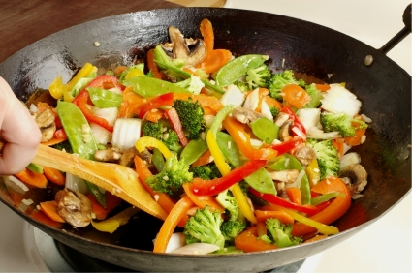
Chinese Cooking Methods
Four main cooking methods:
Stir Fry
Steaming
Deep Frying
Simmering
* Sometimes Roasting

Slide 9
Stir Fry
Most common cooking method
Meat, poultry, fish, and vegetables can be stir fried
Must cut all ingredients into uniforms pieces so they cook evenly
To Stir Fry:
Heat a small amount of oil in the wok.
When oil becomes hot, add the ingredients that need the longest cooking time (meats).
Then add the ingredients that cook more quickly.
Stir continuously throughout cooking period.
When vegetables are crisp-tender, the dish is ready to serve.
* Sometimes you might add a little stock or water and seasoning to form a sauce.
* Stir fry foods cook rapidly so you must watch them carefully
Food retains color, texture, flavor, and nutrients.
Must serve immediately or vegetables will lose texture and flavor.

Slide 10
Steaming
Second most common cooking method in China
Most Chinese don’t have ovens, so steaming replaces baking.
Can steam meats, poultry, dumplings, bread, and rice.
**Water should never touch food.

Slide 11
Deep Frying
Seals juices in and gives food a crisp coating.
Meat, poultry, egg rolls, and wontons are often deep fried.
To Deep Fry:
Cut foods into cubes
Can coat cubes with cornstarch or dip them into a flour and egg batter.
Plunge coated food into hot fat a few pieces at a time.
Drain all deep fried foods on absorbent paper

Slide 12
Simmering
May prepare Chinese soups and large pieces of meat by simmering
Cook ingredients in simmering liquid over low heat

Slide 13
Roasting
Roast pork and poultry
First rub meat or bird with oil and/or marinate
A quick searing over an open flame makes skin crisp
Place meat or bird on a rack or hang it on a hook to roast slowly
Peking duck-most well knows roasted dish.

Slide 14
Chinese Grain Products
Rice
the backbone of Southern Chinese diets
Rice is inexpensive and filling
Short grain rice is used to make flour and translucent rice noodles.
Rice flour used to make pastries and dumplings
Long grain rice used as a side dish and the main dish (fried rice)
When ready to serve rice should be fluffy with firm, distinct grains.
Noodles:
In some parts, noodles or flat pancakes made from wheat flour are used in place of rice
Lo Mein Noodle- made from flour and egg and resembles spaghetti

Slide 15
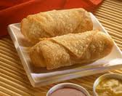
Chinese Grain Products
Wheat Flour:
Used to make the skins or wrappers for wontons (dumplings) and egg rolls.
Dough for both contain wheat flour and eggs.
Egg rolls and wontons usually filled with a mixture of minced vegetables and meat, poultry, or shellfish.
Wontons are prepared by steaming, deep frying, or boiling in soups.
Egg rolls are usually deep fried.

Slide 16
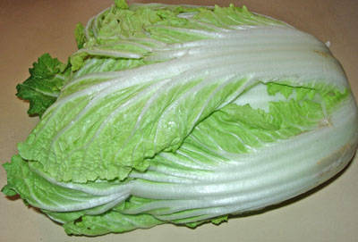
Vegetables
Used to a greater extent than meat
Grow a variety of vegetables
Chinese cabbage
Broccoli
Spinach
Pea Pods
Radishes
Mushrooms
Cauliflower
Can be eaten alone, in salads, and in soups.
Also used to stretch small amounts of meat, fish, and poultry.
Make cooking economical and nutritional.
Chinese Cabbage

Slide 17
Main Dishes
Eat little beef
Beef is scarce and not very good.
Some religions forbid eating beef and pork
Sweet and sour pork is popular among those that can eat it.
Fish is more important to the diet than meat
Consider eggs a sign of good luck
Eat chicken and duck eggs

Slide 18
Tea
Tea is a national drink
Serve black teas
Oolong teas
Green teas
**Black tea is called red tea because black is an unlucky color.
Some teas are scented with fragrant blossoms
Never add cream, lemon, or sugar to tea
Usually served at the end of the meal
Also served to arriving and departing guests as a sign of hospitality.

Slide 19
Meals
Eat 3 meals a day
Breakfast- may be just a bowl of congee (a thick porridge made from rice or barley), rice, or boiled noodles.
Lunch and dinner are similar
For both, all dishes are served at once
Soup placed in center of table
Four other dishes of pork, chicken, or fish with or without vegetables and one vegetable dish surround soup.
Rice always accompanies the main dish.
Use chopsticks as eating utensils for all dishes except soup and finger foods.

