Slide 1
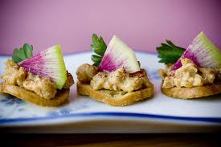
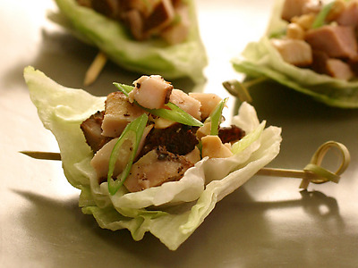
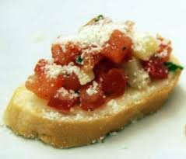
Hors d’Oeuvres, Appetizers, and Sandwiches

Slide 2
Hors d’Oeuvres
French for “outside the meal.”
Meant to pique the taste buds and perk up the appetite.
Foods served as Hors d’Oeuvres should be:
Small enough to eat in 1-2 bites
Some are eaten with fingers, while others use a plate and fork, RARELY use a knife
Attravctive
May be served hot or cold
Often are salty to promote drinking

Slide 3
Appetizers
Meant to Stimulate the appetite, NOT kill it off
Difference between Hors d’oeuvre- when it is severed
Appetizers are traditionally the first course
Larger than hors d’oeuvres
Most are small servings with very flavorful foods
Meant to take just enough edge off the appetite to permit thourough enjoyment of the entree.
May be served hot or cold
Salads may be served as an appetizer

Slide 4
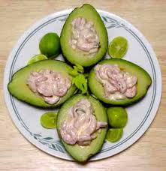
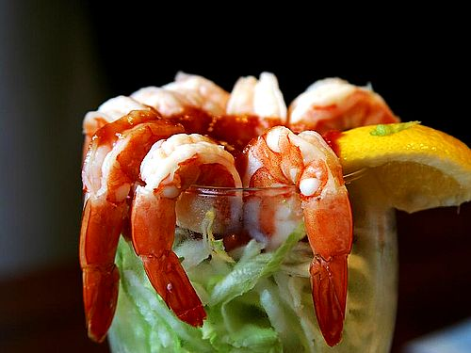
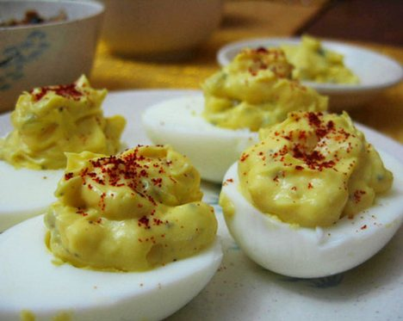
When Serving Hors d’Oeuvres & Appetizers
Offer a variety of flavors and textures
Should compliment the meal to follow
Make a good first impression

Slide 5
Common Hot Appetizers and Hors d’Oeuvres
Grilled, Steamed, Baked, or Roasted Vegetables
Served with a dipping sauce or dressed with a vinaigrette
Mushroom caps are sometimes suffed and baked
Crab Cakes
Crab meat mixed with mayonnaise, herbs, and spices.
Formed into patties, and sauteed.
Chicken Wings
Buffalo style- deep fried after being dipped in a spicy coating
Thin vinegar-based hot sauce is then poured on
Usually served with bleu cheese dressing, with celery sticks on the side
Meatballs
Highly seasoned ground meat
Often served with a sweet-sour sauce
Pasta
Small portions of pasta may be served as an appetizer

Slide 6
Common Cold Appetizers and Hors d’Oeuvres
Canapes
Bite sized pieces of bread or crackers with a savory topping
Bruschetta
Toasted bread drizzled with olive oil and topped with tomatoes, olives, cheese, or other ingredients.
Raw Seafood
Just shucked clams and oysters served with a variety of sauces
Pickled Vegetables
Cheese
Raw Vegetables
Pate
A well seasoned baked mixture of ground meat, fish, poultry, or vegetables.

Slide 7
Sandwiches
Increasingly popular
Find on Breakfast, Lunch, and Dinner menus
Found at Fastfood restauraunts to Fancy restaurants
Combination of four simple elements
Bread
Spread
Filling
Garnish

Slide 8
Sandwhiches
Bread
MUST be fresh and tasty
Spread
Add additional flavor and typically act as a moisture barrier for the bread
Most common spreads are: butter and mayonaise
Filling
The “Centerpiece” of the sandwich
Can be hot or cold
Most common: Meat & Poultry, Seafood & fish, Vegetables, Cheese, and Eggs
Garnish
Decorative
Edible accompaniments on a plate with a sandwich
Examples: Fruit, Pickle, Lettuce, Sprouts

Slide 9
Cold Sandwiches
Often filled with sliced meats and cheese or maynnaise-based salads such as egg salad, chicken salad, or tuna salad.
Six main types of cold Sandwiches:
Closed Sandwich
2 pieces of bread, with a filling between.
Open Faced
Uses only one slice of bead topped with ingredients
Finger Sandwich
Also called a Tea Sandwich
Cut into various shapes ( diamonds, circles, triangles, etc)

Slide 10
Cold Sandwiches
Hero Sandwich
A large closed sandwich.
Often called: “Submarine,” “Hoagies,” “Grinders,” etc.
Filled with thinly sliced meats, cheese, tomatoes, and lettuce
Club Sandwich
A double decker closed sandwich
Uses 3 slices of bread ( or toast), filled with chicken, bacon, lettuce, and tomato
Usually cut into 4 triangles, (making it easier to eat) and held together with toothpicks.
Wraps and Pita Pockets
Rolled up
Tortillas or flat round bread are commonly used
Can hold many ingredients and the opening i s only at the top

Slide 11
Hot Sandwiches
Four Main Types
Sandwich with Hot Filling
A Closed Sandwich, Hero Sandwich, Club Sandwich, and a Wrap can all have hot fillings
Other examples: Hamburger, and Hot Dog
Grilled Sandwich
First the sandwich is assembled
Then outside of bread is spread with butter
Then cooked directly on the heat source
Examples: Grilled Cheese and Reuben

Slide 12
Hot Sandwiches
Pressed Sandwich
A Sandwich Press is used
Press compresses and grills them until they are hot and heathed through on the inside
Examples: Panini, Cubano
Hot Open Faced Sandwich
Served on toasted bread, topped with gravy or sauce
Sometimes Mash Potatoes are added
Example: Eggs Benedict

