Slide 1
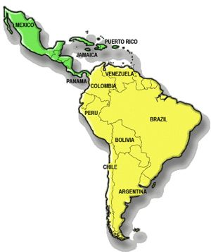
Latin America

Slide 2
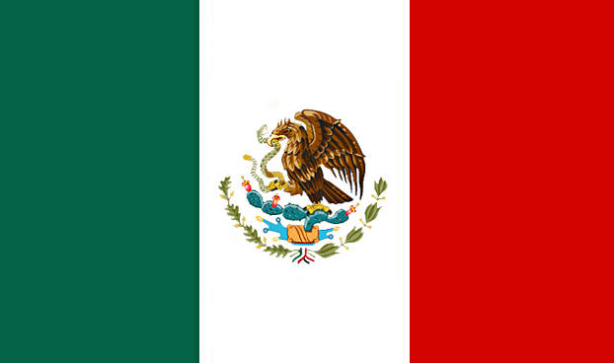
Mexico
Of all Latin American countries, Mexico is the most familiar to people in the United States.
Mexican Cuisine:
Aztecs & Spaniards made many contributions to the Mexican Cuisine.

Slide 3
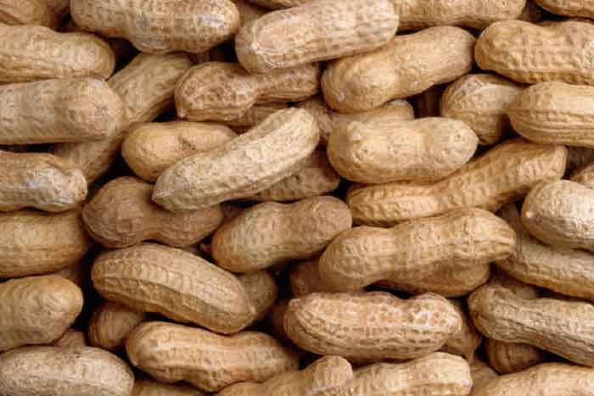
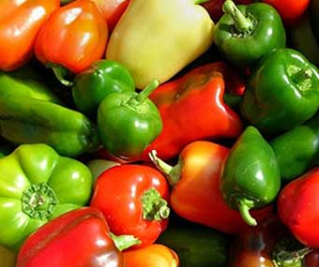
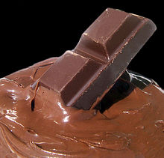
Mexico
Aztecs
Chocolate
Vanilla
Corn
Peppers
Peanuts
Tomatoes
Avocadoes
Squash
Beans
Sweet Potatoes
Pineapples
Papayas
Aztecs boiled, broiled, or steamed their food, or ate it raw.

Slide 4
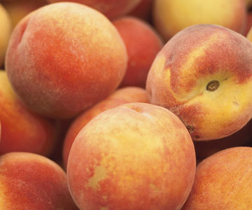
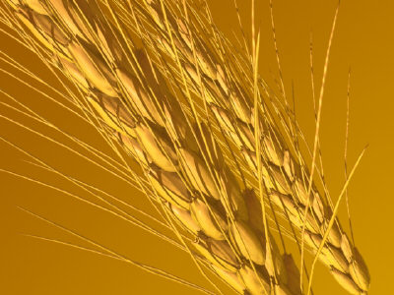
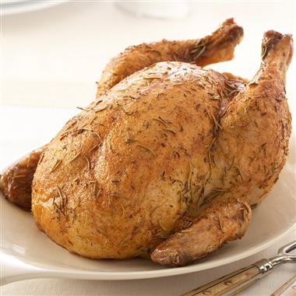
Mexico
Spanish
Oil
Wine
Cinnamon
Cloves
Rice
Wheat
Peaches
Apricots
Beef
Chicken
With the introduction of oil, many of the early Aztec foods could be fried.
Today frying is an important part of Mexican cooking.

Slide 5
Characteristic Foods of Mexico
Corn, beans, and peppers are staple ingredients in Mexican cuisine
They use a variety of other locally grown vegetables and fruits
Flavorful sauces & stews, as well as some distinctive desserts and beverages, are also typical foods in Mexico.

Slide 6
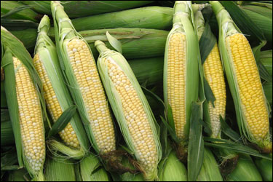
Characteristic Foods of Mexico
Corn:
Formed the basis of Mexican cuisine since the days of the Aztec civilization
Use it in many ways
Most important use is in the production of tortillas- flat, unleavened bread made from cornmeal and water.

Slide 7
Many popular dishes start with the tortilla
Enchiladas- tortilla filled with a mixture of shredded meat or sliced chicken, onions, garlic, and chilies
Tostadas- fry tortillas until crisp, and garnish with chopped onions, chilies, beans, shredded lettuce, meat, and cheese.
Quesadillas- deep fried turnovers made of tortillas filled with meat, sauce, cheese, beans, or vegetables.
Burritos- tortillas wrapped around a meat or bean filling
Tacos- crisp, fried tortillas, filled with meat, beans, shredded lettuce, cheese, and seasoned with chili.
Cooks in Mexico never waste corn

Slide 8
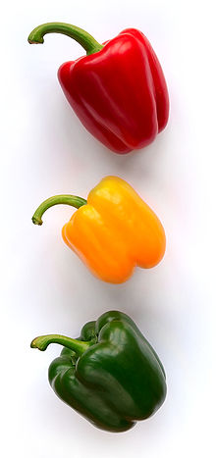
Beans
Often cook beans until soft, then mash and fry slowly =frijoles refritos (refried beans)
Frequently served with grated cheese.
Peppers
People throughout Latin America use peppers- but are especially important in Mexico.
Mexican cooks use over 30 varieties of peppers
Peppers range in size and color
Can be sweet, pungent, or burning hot
Mild peppers are called sweet peppers
Hot ones are called Chilies
Peppers used most often in cooking- Red and Green peppers
Red- used dried, except for ripe red bell peppers and pimentos
Green- used fresh

Slide 9
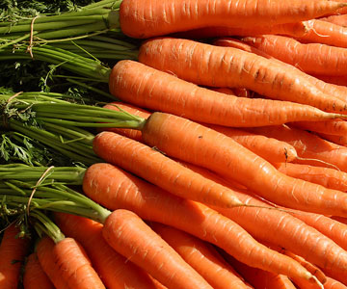
Mexican Vegetables & Fruits
Farmers grow a variety of vegetables
Usually don’t eat them plain
Added to casseroles and as garnishes for other dishes
Most common vegetables in the U.S.
Zucchini
Artichokes
White potatoes
Spinach
Chard
Lettuce
Beets
Cauliflower
Carrots

Slide 10
Mexican Vegetables & Fruits
Many fruits grow in Mexico
Avocados have a bland flavor, often added to other foods.
Ex. Guacamole- spread made from mashed avocado, tomato, and onion
Bananas, pineapples, guavas, papayas, and prickly pears also popular fruits
Fruits often served alone, or in a syrup as a light refreshing dessert.

Slide 11
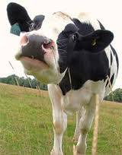
Mexican Regional Cuisine
North Mexico
Grow wheat and raise cattle
Make tortillas wheat not corn
Commonly eat beef
Cheese is popular
Costal Areas
Finfish and shellfish important protein source
Use seafood in appetizers, soups, and main dishes

Slide 12
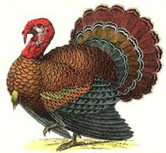
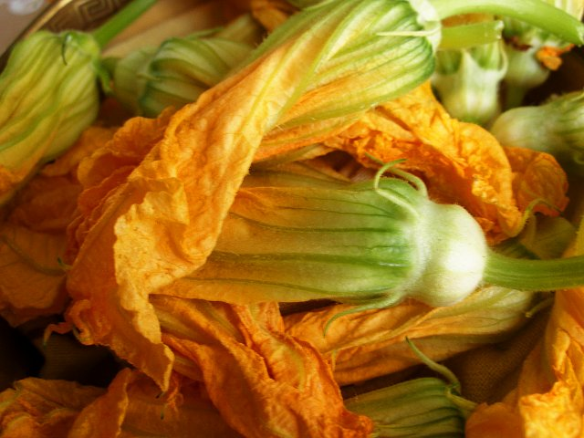
Mexican Regional Cuisine
Eastern
Wild duck is popular
Turkey is one of the most
important foods in the Yucatan
Southern
Squash blossoms and sea chestnuts are popular

Slide 13
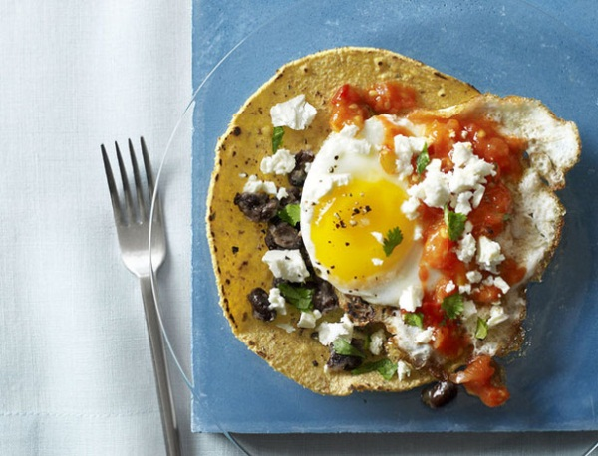
Mexican Meals
Families with ample incomes often eat 4 meals a day.
Desayuno- substantial breakfast
Huevos Rancheros- eggs prepared with chilies and served on tortillas
Comida- main meal of the day
Served between 1pm-3pm
Six courses would not be unusual
Tortillas traditionally served
A siesta (rest period) usually follows comida

Slide 14
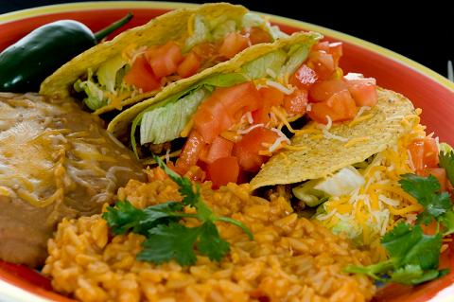
Mexican Meals
Merienda- light snack
Served around 5pm-6pm
Cena- supper
Served around 8pm- 10pm
Similar to comida, but smaller, and lighter
Many families combine Merienda and Cena and eat one meal in the early evening

