Slide 1
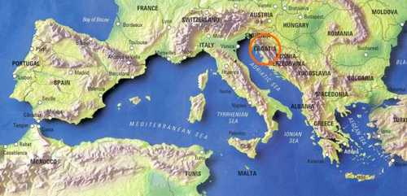
Mediterranean

Slide 2
There are three European countries that lie along the Mediterranean Sea:
Spain
Italy
Greece

Slide 3
Diet
Because of similar climates and resources, the cuisines all resemble each other.
Fruit is served at the end of meals rather than desserts.
Pasta, rice, and/or bread are the staples at most meals
Olive oil is the main cooking fat
Eat a lot of seafood, and only limited amount of red meat.
Diet is fairly low in fat.

Slide 4
Spain
Best described as del pueblo- food of the people.
It is simple
Use fresh ingredients & basic preparation methods

Slide 5
Characteristics of Spanish Cuisine
Spaniards made many contributions to Mexican cuisine
Spanish cooking differs from the spicy cooking of Mexico.
Tomatoes, onions, and garlic form the base of many sauces.
Garlic, pepper, and paprika flavor many main dishes, soups, and salads.
Traditional Spanish cooking method is to slowly simmer foods in earthenware pots.
Common to mix two or more food flavors in a single dish:
Ex.
Meat and Fish
Fish and Vegetables
Meat, Fish, and Rice

Slide 6
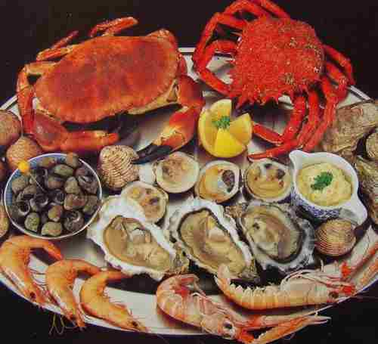
Meals
Meals often begin with tapas (appetizers)
Salads often follow tapas
Soups are also popular throughout Spain
Gazpacho- popular soup made with coarsely pureed tomatoes, onions, garlic, cucumbers, and green peppers, olive oil, and vinegar.
Spaniards are experts at preparing seafood.
Veal, lamb, & pork are the most popular meats eaten

Slide 7
Meals Cont.
Similar to Mexican meals with the same names:
Breakfast- Desayuno
Ex. Coffee or chocolate drink
Sometimes bread & jam or sweet roll
Ex. Churro- thin pastry fried in deep fat
Second Morning Meal- Almuerzo
Served around 11 o’clock
More substantial then desayuno
Varies depending on locale and personal taste
Ex. An omelet, grilled sausage, fried squid, open faced sandwiches, fish or lamb chops.

Slide 8
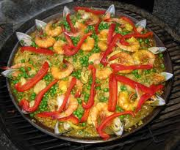
Meals Cont.
Lunch-Comida
Main meal of the day
Served around 2-3 o’clock
Ex. Fish, poultry, or meat that follows a salad or soup. Fruit or another light dessert ends the meal.
Snack- Merienda
Served around 6 o’clock
Light snack of cakes and cookies or bread and jam
* If a family has visitors, the meal may be more substantial.
Supper- Cena
Light meal
Similar to Almuerzo

Slide 9
Italy
Cuisine:
It is the source of many Western Cuisines
Italian’s laid the foundation for Haute Cuisine
As a whole it is lively, interesting, colorful, and varied
Yet simple
Italians believe in keeping the natural flavors of food
Insist on fresh, high quality ingredients
Do not over indulge in convenience foods
Use many kinds of herbs, spices, and other seasonings
Fresh fruits and vegetables are very important
Prepare many dishes on top of the range either by simmering or frying
Introduced ice cream to the rest of Europe.

Slide 10
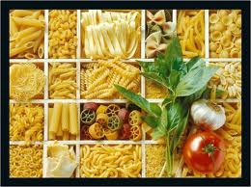
Staple Foods
People throughout Italy eat pasta
Pasta may be served in many ways, but always cooked al dente
“Slightly resistant to the bite”
After pasta, seafood is second in popularity
Rice is both an important agricultural product and a staple food.
Pork, lamb, veal, and beef are also produced and eaten.

Slide 11
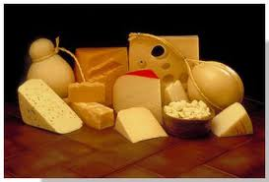
Italian Dairy Products
Best known in the U.S. are:
Parmesan
Mozzarella
Romano
Ricotta
Provolone
Gorgonzola
Italians introduced ice cream to the rest of Europe

Slide 12
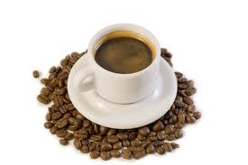
Italian Beverages
Caffé Espresso- rich, dark, flavorful coffee served thoughout Italy
Made in special type of coffee maker- caffettiera
Dark roasted, finely ground beans must be used.
Even more important that caffé espresso is vino (wine)
Children drink it
Mild Burgundy or Chianti usually replaces water at meals.

Slide 13
Regional Italian Specialties
Geography & climate create a culinary division between North and South Italy.
NORTH:
Has more resources that Southern Italy
Meat is easier to obtain & less expensive
Dairy products are more common
Foods not as heavily spiced as in the South
Use delicate sauces instead of heavier tomato sauces
Butter is the favored cooking fat
Home of fat ribbon shaped groups of pasta called Pasta Bolognese

Slide 14
Regional Italian Specialties Cont.
SOUTH:
Farming & grazing land is poor quality
Sparsely populated, many people are lower income
Meat is expensive & eaten in small amounts
Dairy products except cheese are rare
Olive oil preferred cooking fat
Home of tube shaped groups of pasta called Pasta Napleotania
Southern Italian cooking is the cooking which most people in the U.S. are familiar with
Most Italian restaurants in the U.S. are Neapolitan
Naples is the heart of Southern Italian cooking ( Pizza originated here).

Slide 15
Italian Meals
Eat a light breakfast & a hearty noon meal
Noon meal is the largest meal of the day, usually eaten at home
Antipasto- an appetizer course that often begins the meal
Regardless of the selection of foods, the tray must have both: color and taste appeal!
Minestra (soup) may follow or replace the antipasto at the start of the meal
Main course- a meat, poultry, or fish dish usually follows the soup.
A vegetable or salad usually accompanies the main dish
Fruit and cheese end a typical meal
Reserve fancier desserts for special occasions
Evening meal- very light

Slide 16
Greece
Staple Foods:
Make liberal use of:
Lemon Juice
Tomatoes
Green Peppers
Use many herbs and spices to bring out natural flavors
Serve eggplant as a side dish or add it to the main dish
Moussaka- layered slices of eggplant, ground lamb, and cheese
Lamb has been raised in Greece for centuries.
Serve it roasted as a filling for veggies and add it to soups and stews

Slide 17
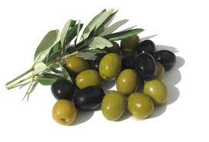
Staple Foods Cont.
Seafood:
Prepare by baking or broiling
Squid is popular
Taramasalata- a pate made from fish roe (eggs), popular appetizer or snack
Olives:
Grow in an abundance
Flavor of olive oil dominates Greek cuisine
Eaten as an appetizer and snacks, or added to other dishes
Honey:
Greek honey is world famous
Basic sweetener used in preparation of many Greek desserts, pastries, and cakes

Slide 18
Greek Meals
Meals reflect simplicity
Breakfast- no more than a slice of dry bread and a cup of warm milk
Lunch and Dinner- hot meals
Lunch is at noon
Dinner is late evening
Usually serve sweets only on special occasions
Make desserts with phyllo- paper thin pastry made with flour and water

