Slide 1
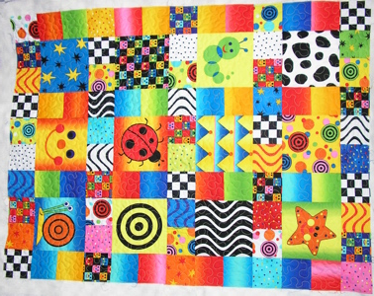
Quilting Terms

Slide 2
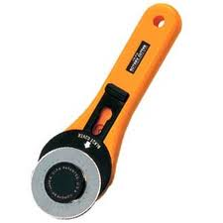
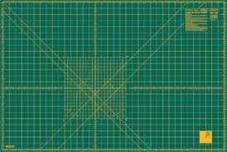
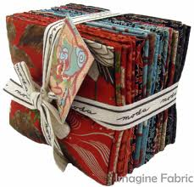
Rotary Cutter: a razor blade wheel, which allows fast, accurate cutting through several layers of fabric.
Cutting Mat: A special protective surface on which a rotary cutter can be used safely.
Fat Quarter: A piece of fabric cut half width ( approx. 22”) by 18”.

Slide 3
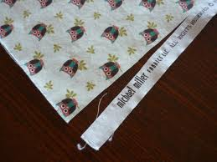
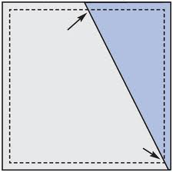
Selvages: The lengthwise woven edges of the fabric. Selvages are more densely woven than the rest. Do NOT use the selvage!
Seam: the line of stitching that joins patches or other parts of a quilt.
Seam Allowance: The part between the seam line and the cute edge. Usually ¼” wide.

Slide 4
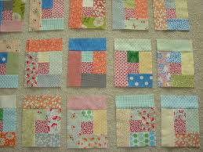
Pressing: LIFTING and PLACING the iron to flatten seam allowances and fabric. DO NOT move the iron back and forth. * Press lighter fabrics to darker*
Block: A design unit, usually a square that is repeated to make the quilt top.
Right Side of Fabric: The side that has the print or finishes and will show in the finished quilt.
Sashing: Strips of fabric between blocks. Sashing separates blocks.

Slide 5
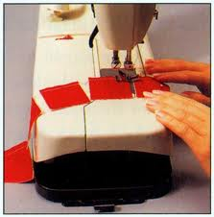
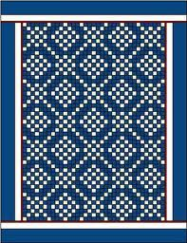
Piecing: Joining together seams.
Chain Piecing: A technique of machine sewing pairs of patches or units one after the other without lifting the presser foot or clipping threads between. * Threads are cut later
Border: The outer area of the quilt (inside the binding) Much like a frame on a picture.

Slide 6
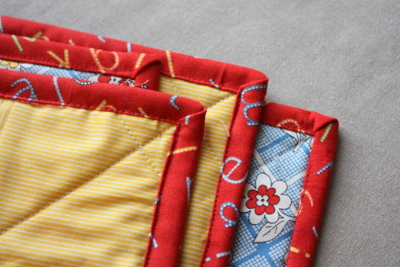
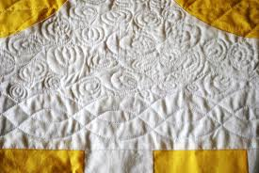
Binding: A strip of fabric used to encase the edges of a quilt.
Batting: The filler or middle layer of the quilt.
Quilting: The stitching that holds the quilt’s three layers together. Adds texture to the quilt.

Slide 7
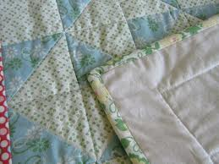
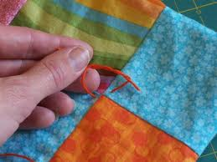
Stitch- In- The- Ditch: A line of quilting stitches that is right next to a seam.
Tying: Fastening the layers of the quilt with yarn.

Slide 8
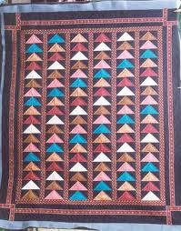
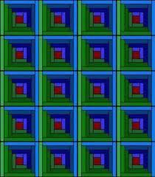
Styles of Quilts
Flying Geese: uses triangles that represent geese flying in a V
Log Cabin: a pattern symbolized by a small square in the middle with strips sewn around all four sides.

Slide 9
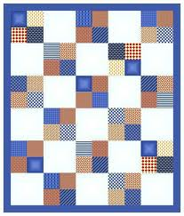
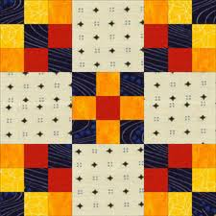
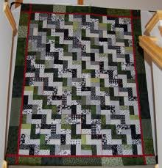
Quilt Styles Cont.
4 Patch and 9 Block:
Rail Fence: a pattern using three fabrics that looks like a picket fence or zigzag line when layered into a quilt.

Slide 10
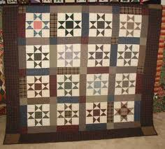
Quilt Styles Cont.
Ohio Star: a nine-patch block made with five plain squares and four quarter-square triangle units.

